Slide 1
User Sentiment Across Time
Sourabh Shetty
CS6704: Advanced Topics In Software Engineering

Slide 2
Initial Plan
Initially planned to do sentiment analysis on GitHub commits messages.
Literature survey confirmed that most of my ideas had already been done.
Had to change the topic.
After discussing options with the instructor, chose the new topic.

Slide 3
User Sentiment Across Time
Many forums have active user bases.
The comments of these users have been collated and are available to be analyzed.
Use one such dataset to analyze user sentiment.
Sentiment analysis about a particular topic has been done to death.
This project sees if a user’s general sentiment changes across time.

Slide 4
HackerNews
The choice of dataset for me was HackerNews.
HackerNews is a link-based social website that focuses on computer science and entrepreneurship topics.
It has an active and passionate user base.
More focused conversations than reddit and similar websites.
Dataset available on Kaggle.

Slide 5
Obtaining the data
Kaggle had all the data required for this project.
However, a known bug on Kaggle prevented the created notebook from having any of the required input files.
Fortunately, HackerNews also publishes their data to BigQuery.
Used the Kaggle notebook to query BigQuery for the required information, and downloaded it to my local system.
This was required since Kaggle has a limit on how much memory can be used.
Data downloaded in separate CSV files per user.

Slide 6
Preprocessing
Hit a few errors while initially trying to process the files.
Made sure to open files with utf-8 encoding.
Required some preprocessing:
Remove quoted text since they weren’t the words of the user.
Identified by <pre> tags.
Removed HN specific formatting like ‘>’ followed by a <p>.
Removed all XML tags.
Removed URLs.
Unescaped Unicode characters.
Replaced tabs (\t) with spaces.

Slide 7
SentiStrength-SE
SentiStrength-SE is not actively developed.
Latest version based on an old version of SentiStrength.
No command line functionality.
Had to select and save files one-by-one, breaking the automation.
Tried different configurations, default worked best.

Slide 8
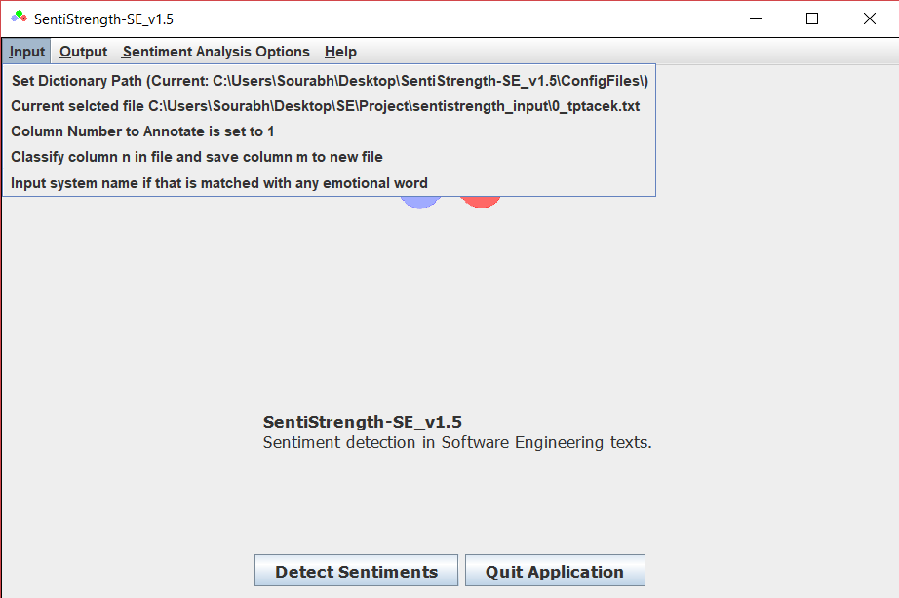

Slide 9
Processing SentiStrength-SE Results
For each user’s comments:
Extract the year and sentiment
Calculate the total sentiment and add it to the year’s dictionary entry.
Calculate average sentiment per year.
Plot it.

Slide 10
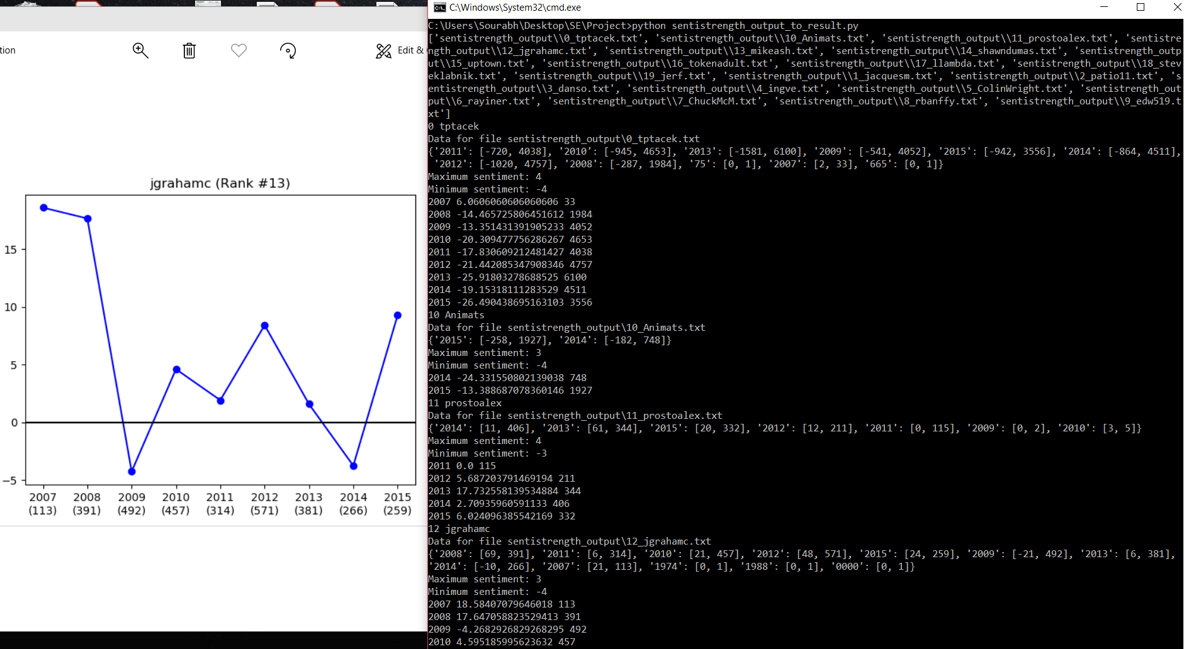

Slide 11
User ‘tptacek’
To demonstrate, I’m going to use the comment history of the user ‘tptacek’.
This user has been active on HackerNews since 2007.
This user has the highest karma on HN and holds the rank 1 on the leaderboard.
This user also had the most number of comments in my dataset.
This makes tptacek a good candidate to analyze.

Slide 12
About the user data
There were originally 35,572 lines of comments.
After a little preprocessing, there were 33,686 comments to work with.
The user had only 33 comments in 2007.
Between ~2000 and ~6000 in later years.

Slide 13
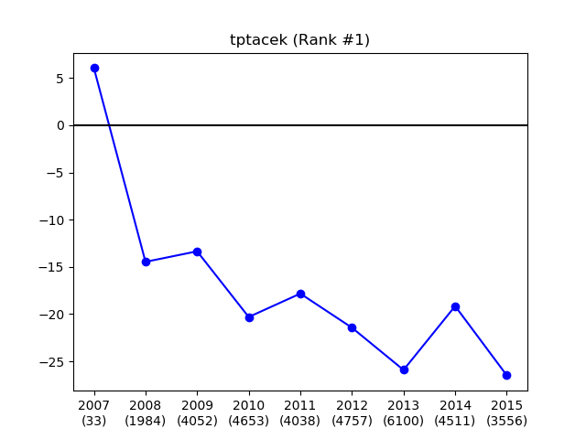

Slide 14
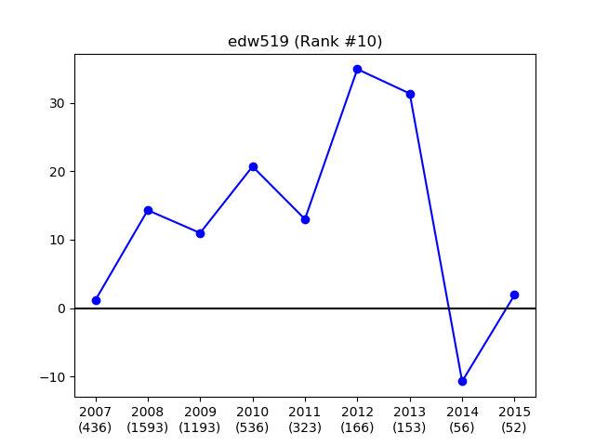
Results
Not much of a real trend was observed.
This is especially true of mostly positive and neutral people.
Negative people did tend to stay more negative.
User ‘tptacek’ became more negative over the years, but this user was not the norm.
Most users varied tremendously across years and most plots look like one on the right.

Slide 15
Problems
This sentiment analysis tool doesn’t well deal with sarcasm.
For instance, this is a recent comment by the user on a post about divorce:
“Stupid women with their stupid agency, self-determination, and independent motivations and life goals. Won't any of them think of the slopes?”
A clearly sarcastic remark made in response to a now flagged comment.
Simple tools like this don’t deal well with nuance.

Slide 16
Future Work and Applications
Further automate this process.
Possibly extend SentiStrength-SE to include SentiStrength’s newer features which help with automation and could possibly give better results.
Analyze more users.
Not just top users, but also a more randomized selection of users.
Possibly use a more advanced tool for sentiment analysis.
Learn math.
Use user sentiment analysis to detect trolling/brigading.
Use this to detect warning signs.

Slide 17
Questions

